Slide 1
Geography Review
The five themes of geographic inquiry

Slide 2
Minds On
Think/ Pair/ Share with your elbow partner: What does the word “geography” mean? What is the study of geography about?
4 Corners Activity: “I think learning geography is important” (Strongly Agree/ Agree/ Disagree/ Strongly Disagree). Be prepared to justify your point of view. Quietly and carefully walk to your corner.
Learning goals for today:
We are reviewing the Five Themes of Geographic inquiry from grade 7.
Social Goal: We are learning to collaborate.

Slide 3
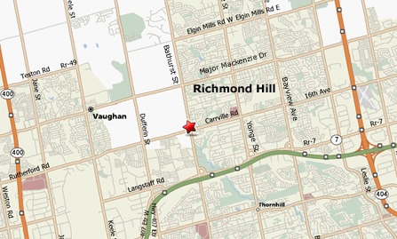
Action
Think /Pair/ Share:
What is it like to live in your community?
How do you get around?
What do you do in and around your community?
What is important to you about your community?

Slide 4
Placemat: Five Themes of Geographic Inquiry!
PLACEMAT PROMPTS TO HELP YOU:
What does it mean? What is it?
Similar words or phrases (other words it makes me think about).
Where have I seen or heard it?
Examples of the word in your life and experience.
Any information related to the word/topic that you know about.
What does it look like? (Feel free to draw).
Write everything! All answers are correct answers, we are brainstorming.
On your tables you will see placemats with various topics related to the Five Themes.
Jot down any ideas, associations, drawings you may have connected to these themes. THINK LIKE A GEOGRAPHER!
THIS IS AN INDEPENDENT ACTIVITY AT FIRST, THEN YOU WILL SHARE WITH YOUR TABLE GROUP USING ROUND ROBIN STRATEGY

Slide 5
STOP and LISTEN:
Place: add “physical & human characteristics”.
Relative location: describe the location of your school using landmarks (arena, park, main roads).
Absolute Location: find latitude and longitude of your school (use atlas).
Environment: add “How humans depend on it?”
Region: add “physical, human, functional”
Interaction: add “how humans affect the environment / positive & negative”
Movement: add “products, people, information”.
Person with the shortest hair will add this information to your placemat, in order to trigger some more ideas.

Slide 6
Definitions of Five Themes
Add more info in your graphic organizer that makes sense to you, based on our placemat activity.

Slide 7
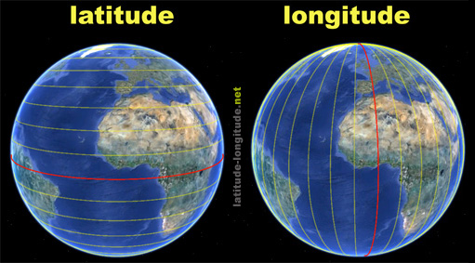
Figure 1. Latitude and longitude. Adapted from “latitude-longitude.net”. Retrieved on February 22, 2014, from http://latitude-longitude.net/help.html
“Where” is the single most important question in geography.
You can answer this question using two methods: relative location or absolute location. Relative location: describes one place in relation to another. Some people give relative location by using familiar landmarks and giving directions or using a Compass directions and distance. I need one volunteer.
Absolute location: if you used GPS or a road map you already know about absolute location. It is the EXACT location of a place independent of any other place. The system of latitude and longitude is an example of absolute location.

Slide 8
Game time!
With a partner, you will practice finding absolute location using longitude & latitude with a battleship grid.
Instructions: using a pencil each player is hiding 2 ships (each ship must occupy three longitude & latitude intersections). A player says “Hit” when the opponent guesses the location correctly.
The winner is the first one to guess all six locations / longitude & latitude intersections.
If there is time, erase, switch and play it again.

Slide 9
Independent Practice
Tell me a little bit about yourself. On the Exit Ticket briefly write your strengths, interests, areas of need, and generally what do you think is important for me to know about your learning style (visual, kinesthetic, auditory).
Homework: locate and label these cities on the World Map organizer:
Toronto, ON 44* N, 79* W
St. John’s NF 47* N, 52* W
London, England 52* N, 0*
Cape Town, South Africa 34* S, 18* E
Sydney, Australia 34*S, 151* E
Tokyo, Japan 36*N, 140* E

