Slide 1
Patterns of Human Settlement
Geography grade 8
unit: Patterns in human geography

Slide 2
Learning Goals for today
We will learn to identify three main patterns of human settlement.
Social goal: active listening, mutual respect and participation.

Slide 3
Personal reflection: how does your life situation compare with the rest of the world? What can we do to become globally responsible citizens? Think/Pair/ Share.
Minds On:
Watch the video from the Miniature Earth Project. If you would like to learn more visit www.miniature-earth.com
The idea of reducing the world’s population to a community of 100 people is very useful and important. It makes us easily understand the differences in the world and at the same time, makes us aware of shared our responsibilities in the Global Village Earth.

Slide 4
Big Ideas for this unit
Human patterns set countries apart from each other. In Canada we have no shortage of land, and many opportunities to enjoy a good standard of living. Other countries might have limited resources, or have limited access to technology. human patterns of population, community, development and technology vary widely across the globe.
geographers create maps, graphs and use various geographic sources to help identify the human patterns and analyze them.

Slide 5
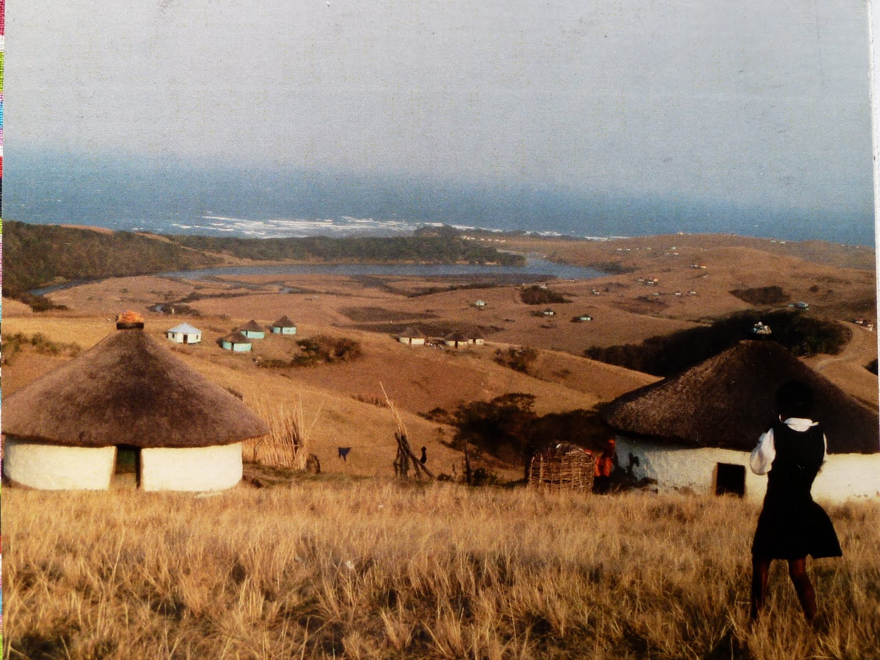
Figure 1: Nelson Rolihlahla Mandela. Adapted from South Africa July to October 2010. by Jerry Forbes. Retrieved February 23, 2014 from http://jerrisimosa2010.blogspot.ca/2010/08/nelson-rolihlahla-mandela-part-3.html.
Droughts, storms, floods, insects and crop diseases can threaten farmers in all areas of the world. Some communities may also face political unrest, war and poverty. How do these factors affect settlement?
Rural settlements usually have a population of fewer than 1000 people, and include farms and small communities. There are many countries with large rural populations, particularly in the developing nations, where people farm or fish to feed themselves and their families. A century ago, more than half of Canada’s population was rural. Today farms are much larger and most rural inhabitants drive to the nearest large town or city to buy what they need.

Slide 6
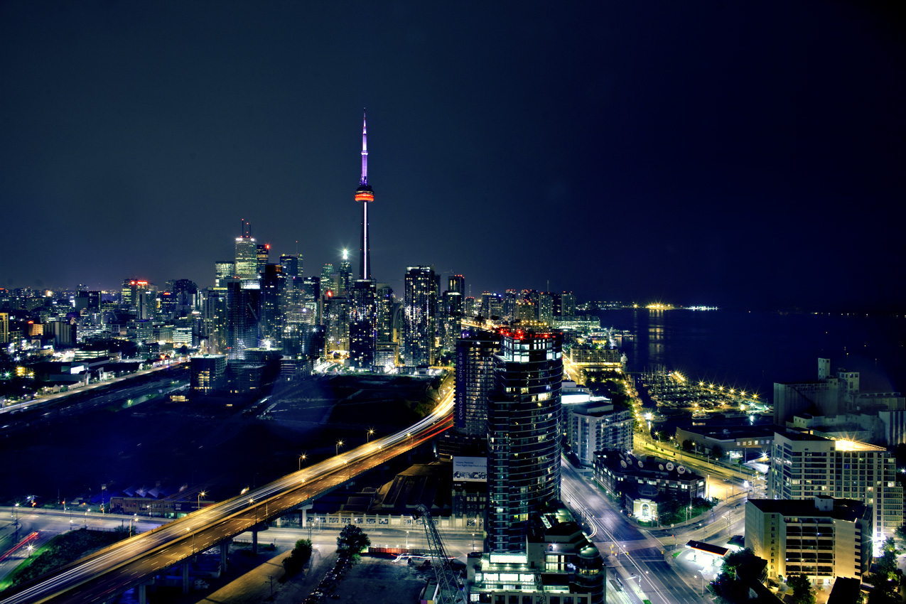
Figure 2: What Steve Nash?. Adapted from www.onesecondleft.com. Retrieved February 24, 2014 from http://www.onesecondleft.com/2012/07/05/what-steve-nash-isnt-a-toronto-raptor/
In some cities in developing nations, housing shortages are severe and conditions are very crowded. Most rural migrants cannot afford to pay for water or electricity, leaving many residents in poverty.
Urban Settlements
80 % of Canadians now live in cities or towns. Urbanization (the increase of urban areas) has been one of the most important changes in human geography patterns since 1950s. That year, only about 25% of the world’s population was urban. Now, it is about 50 %. All around the world people are leaving rural areas and moving to urban centres in search of opportunities for better life. Rapid growth can cause housing shortages, high cost housing and the “tent cities” of the homeless- also found in countries like Canada.

Slide 7
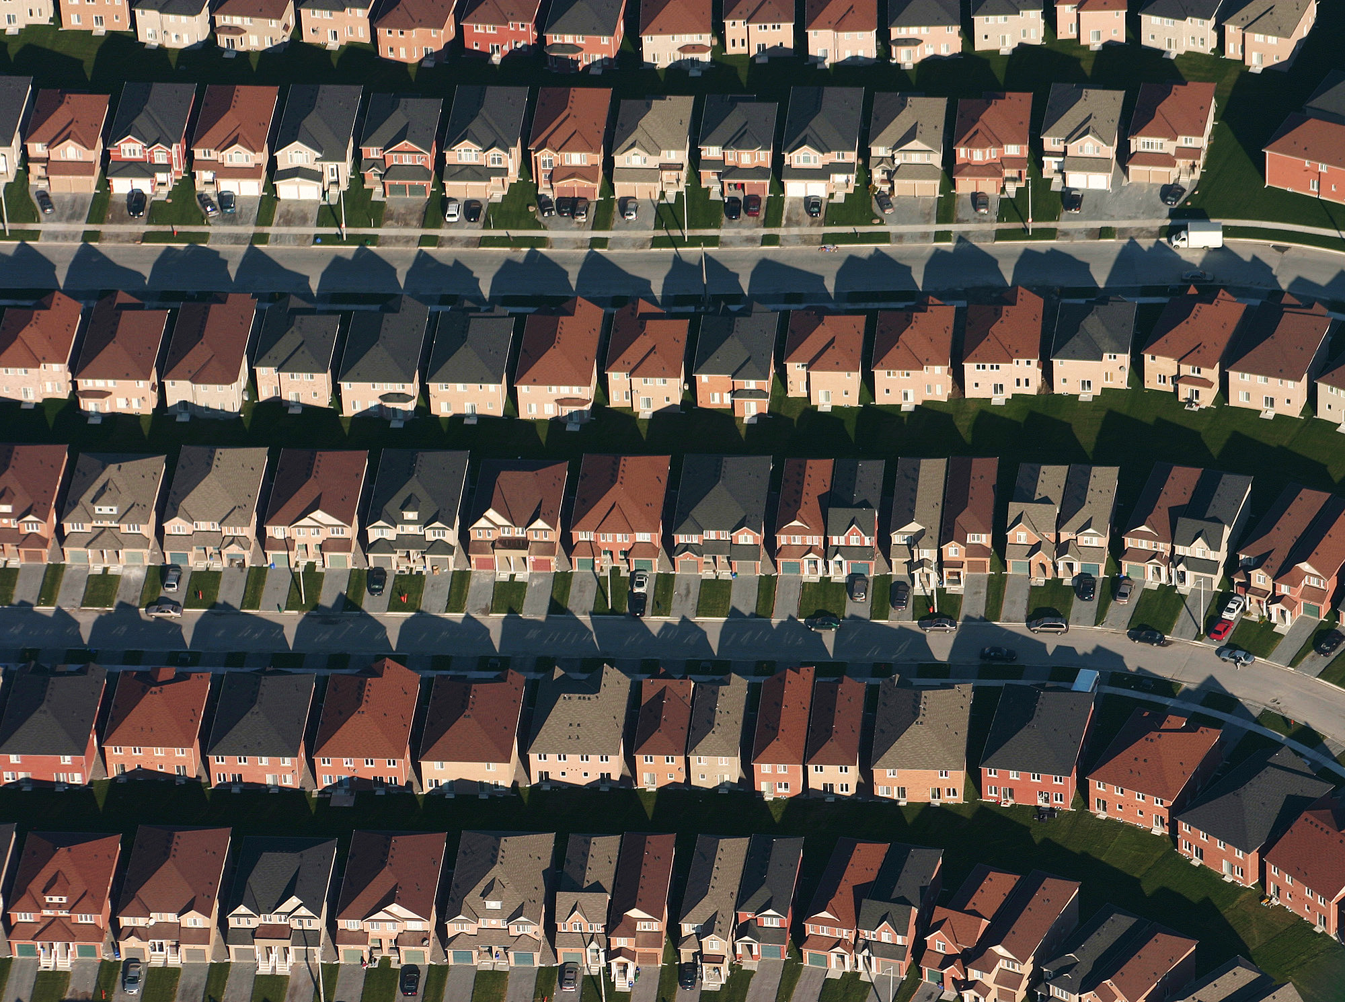
Figure 3: Markham, Ontario. Adapted from Wikipedia. Retrieved February 23, 2014 from http://en.wikipedia.org/wiki/Markham, Ontario.
Why are cities in the developed nations growing so fast? Why have suburbs grown so rapidly in the developed world? Think/ Pair/Share
Suburban settlements:
newer residential communities found at the edges of established cities.
The growth of suburbs has been a population trend in the developed nations since 1950s. Widespread use of car is both a cause and a result of urban growth and suburban settlements. Suburbs have grown because the car makes travel easier and convenient. Increased use of cars adds to the air pollution and decreases the amount of daily physical activity a person might get from walking or cycling to their destination.

Slide 8
Settlement Patterns
People usually live together in big or small groups. Settlements range from villages and small towns to the largest of world cities.
Geographers study the way settlements develop, change and grow.
Let’s look at the three types of settlement patterns!

Slide 9
Choose where you live!

Slide 13
Let’s get up and move!
Group number 1 form a Linear Settlement Pattern.
Group number 2 form a Scattered Settlement Pattern.
Group number 3 form a Clustered Settlement Pattern.

Slide 16
You are the real estate agents now.
Think of the house for sale and in which settlement pattern it is located in. Provide settlement characteristics under each category and try to sell the house to your prospective buyers..
You can work as a table group team. Together brainstorm the positive attributes of living in your settlement.
Try to convince me to buy your house! Be persuasive, but do not forget to include these key categories!
Category | Linearville | Scatterville | Clusterville
Housing
Population Density
Economic Activities

Slide 17
Homework:
Please watch the Miniature Earth video again and complete the quiz. Bring it to our next class.
www.miniature-earth.com
Read and complete the Settlement Patterns handout, questions 1-2.

