Slide 1
Demography, continued.
The Human Pyramids

Slide 2
Learning Goals:
We continue to investigate population characteristics.
We are learning to construct and interpret population pyramids.
Social Goal: active listening, mutual respect, participation, collaboration.

Slide 3
Let’s review:
Minds On: Think/ Pair/ Share what are population characteristics and what do they tell us?
Why do we need information about population characteristics?
Which parts of the world experience a very high increase in population?
Notes:
Birth rate, death rate, literacy rate, life expectancy, fertility rate, doubling time,
We all are a part of world population. You are a part of your school’s population, you are a part of Richmond Hill population, you are a part of Canada’s population and ultimately of World’s population. You are one of 7 billion. Just by living you are affecting the world. How? Think / pair/ share.

Slide 4
Do you remember how a population can change in a country?
It depends on a number of people who are born and die each year.
There is a natural increase when birth rate is higher than death rate.
There is a population decrease when the birth rate is lower than the death rate.
Another reason population changes is immigration.
The difference between the number of people leaving (emigrating) and those coming in (immigrating) is called the net migration.

Slide 5
Population Pyramids
Population pyramids are a type of graph that give information about the number of people in each age group and the balance of males and females in a country’s population.

Slide 6
It’s a visual representation of male and female statistics together in one graph.
Males graph
Females Graph
Notes:
Age and sex, how many males / females and how are are they

Slide 7
The pyramid is divided down the middle to show males on the left and females on the right. The youngest people in a society are shown in the bars at the bottom of the graph. The oldest people are on the top. If you want to predict some of the things that will happen in a country, it helps to know about the age groups. If more people are young, then you must plan for the needs of children, for example education and health care.

Slide 8
Notes:
What can you infer from this population pyramid?

Slide 9
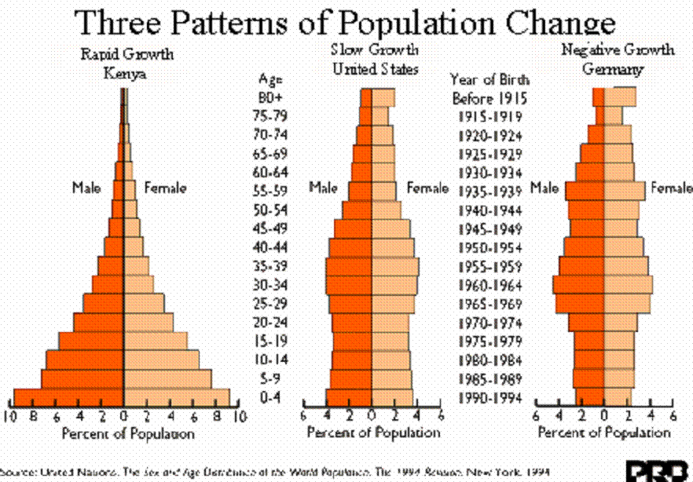
A rapidly growing population like Kenya’s has a wide base at the bottom (a large number of young people) and a narrow top (not many older people). This type of population pyramid is typical of developing countries. A population pyramid that has a narrow base and fairly equal numbers of people in all age groups represent a more developed country. It is stable. What is happening in Germany?

Slide 10
Let’s look into the future.
Comparing Kenya, Canada and Germany. 1950 - 2100

Slide 11
Kenya’s population
1950- 2100
Notes:
What do you see happening in 2050 (36 years from now)? What about the old age? Life expectancy? What kind of changes are occurring there?

Slide 12
Canada’s population
Notes:
How about Canada’s predictions of population growth? What is our biggest section of population? How will this affect you and working generations?
In the year 2050 how old are you going to be?

Slide 13
Germany’s population.
Notes:
What are some solutions for Germany to create a stable population pattern?

Slide 14
It’s your turn to construct a population pyramid.
Task 1: Constructing the population pyramid: working in pairs (A + B), you need two colours of markers, one pyramid sheet and one data sheet
Person A: Tells the recorder the information
Person B: Recorder
Task 2: Interpret the results together, person A records the answers
Task 3: Compare your results with the other pair at your table.
How Canada and Bolivia’s population pyramid differ and how are they similar?
Which of the two graphs shows a greater increase in total population?
How governments may use this information to plan for the future needs of society?
Notes:
Tech support for document camera

