Slide 1
Connections and Consequences
Grade 8
Human Geography
last chapter in the unit!

Slide 2
Learning goals
We are learning to summarize the factors that affect patterns of urbanization, industrialization, agriculture and transportation.
Social Goal: active listening, mutual respect, participation, collaboration.

Slide 3
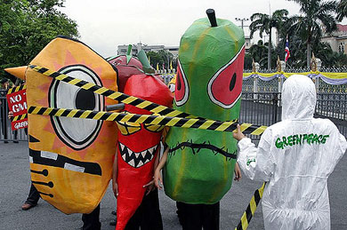
Minds On
Notes:
What do you think is happening in this photo? Thailand Greenpeace protest against GM foods after the government official said they might lift the ban on gm foods in Thailand. How do you think genetically modified food production is connected to global population?

Slide 4
Action: changes in agriculture, urbanization, industrialization and transportation often introduce many issues and concerns:
food security: food shortages are likely to occur as world population grows
water quality and use: animal waste and pesticides are polluting lakes and rivers; pesticide overuse may kill many beneficial species, possibly affecting human health; over-irrigation can cause soils to lose their fertility
urban growth: good farmland may disappear as cities sprawl into the countryside
soil quality: high technology farming methods, along with heavy use of fossil fuels, may cause long-term damage and erosion
farm ownership: communities may change as traditional family farms are transformed into corporation factory farms
genetic engineering: new bioengineered foods may pose a threat to the health of people and ecosystems

Slide 5
Dealing with issues
Problems are very complicated and difficult to solve (think about the global population increase for the next 35 years!)
Humans still struggle in their efforts to create a better world.
By studying these issues we can better understand our connections with the world, gain greater awareness of social and economic problems and try to find solutions!
We have no choice, we have to find a way towards global sustainable future!

Slide 6
There are many factors that cause change.
They are interconnected and interdependent (each of them is dependent on what is happening with the others).
They are often grouped as: social, political, cultural, economic and environmental factors.
However, demographics (human patterns and social trends) as well as changing technology have the greatest impact.
Many of the factors that cause change are the result of decisions made every day by people around the world, including YOU.
Notes:
Last time we looked at factors affecting urbanization.

Slide 7
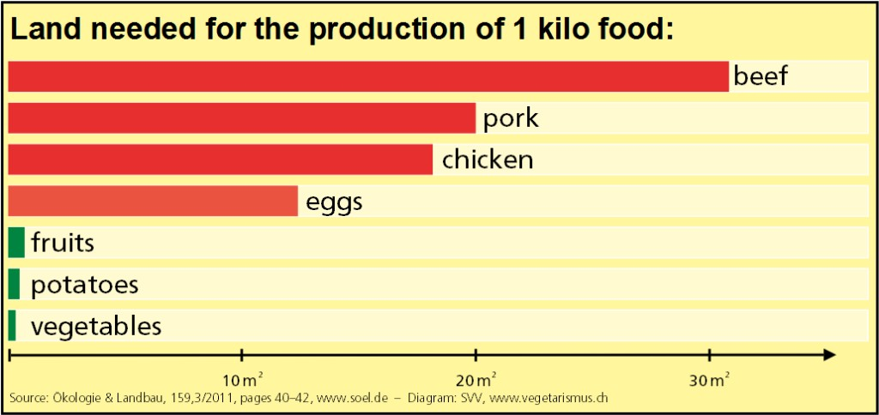
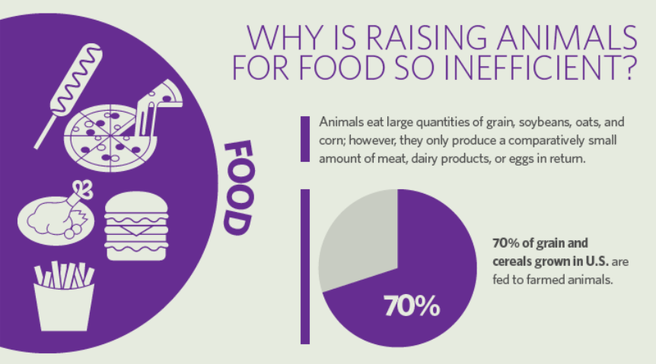
For example: food choices you make.
All the grain that is fed to livestock around the world – about 40 % of the total grain produced –would feed five times as many people as it does after it is converted into meat. As world population continues to grow, the demand for food will increase. If wealthy people in the world reduced the amount of meat they ate by just 10 %, 65 millions tonnes of grain would be available for people to eat!
Notes:
For example: the annual per capita consumption of meat in kg in Canada is 70 kg, in the US 110 , in China 22 and in India 1 kg.

Slide 8
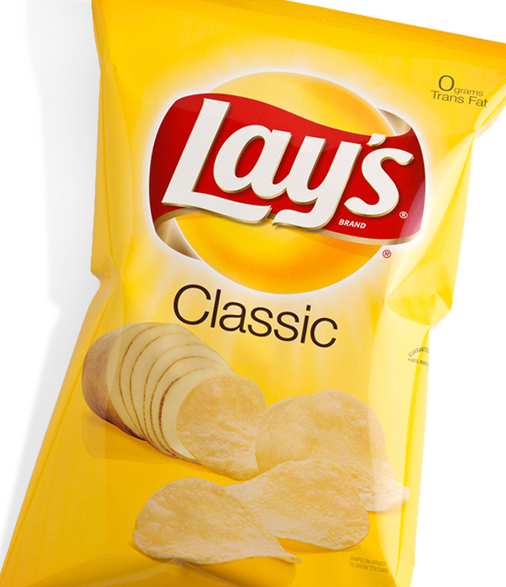
Industrialization + agriculture= processed foods
Turn to page 92 in your textbook and see how processing potatoes into your favourite chips reduces the nutritional value of the food and increases the price of the final product.
How industrialization and transportation are connected?

Slide 9
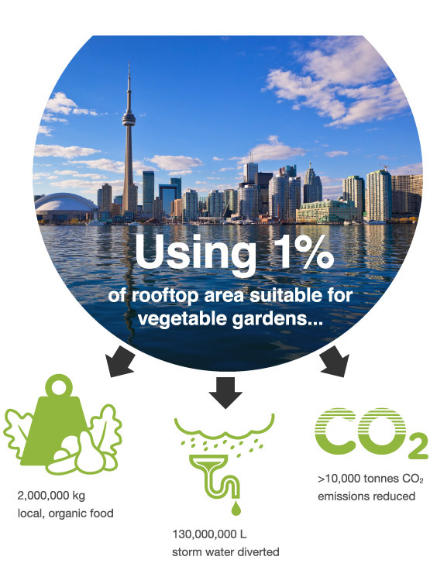
Meeting the challenge: how can we take better care of resources we have?
protect croplands from being changed to other uses (i.e. urban sprawl like Richmond Hill)
invest more in agricultural research and more effective irrigation methods (50 % of available fresh water is used for agriculture)
reduce the world’s consumption of meat
encourage home gardening
alternatives to use of pesticides include crop rotation, natural pest predators and growing crops that are naturally resilient
organic farming: method of growing food without fertilizers, antibiotics, growth hormones
Notes:
organic produce is more expensive, but it is not mass produced and relies on a variety of natural methods to maintain healthy soil and food production

Slide 10
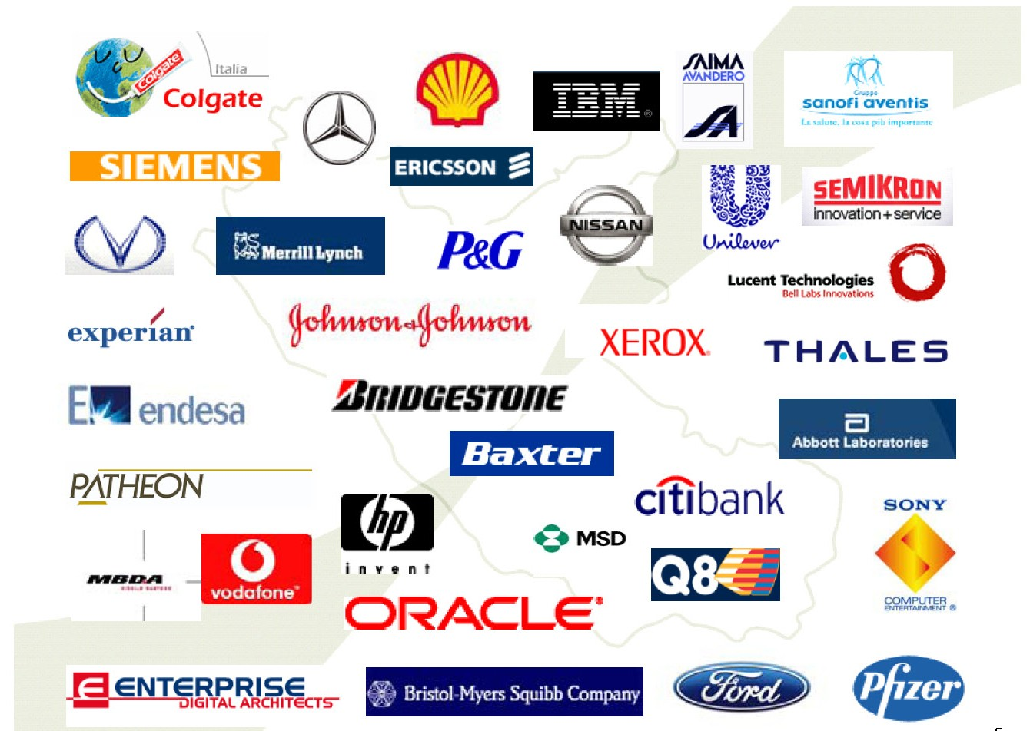
Another factor of change: Globalization
Globalization is a major trend sweeping the world.
It affects a wide range of activities in agriculture, urbanization, industrialization and transportation.

Slide 11
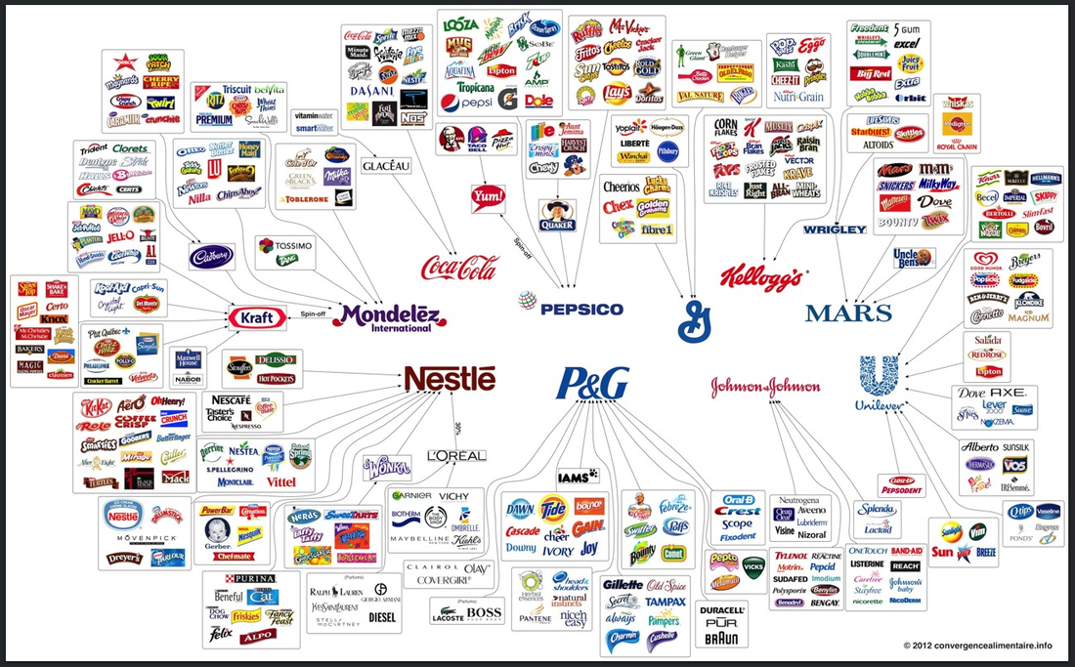
Globalization includes the spread of:
media and entertainment
electronic communication
rising levels of trade
international investment
travel and migration
increased personal consumption and spending
rapid changes in technology
growth of transnational corporations
Transnational corporations control 80 % of the world’s trade and 80 % of the world’s croplands.
Notes:
Transnationals operate across national borders and are sometimes beyond the control of any government. Governments, particularly in developing countries, often give in to the demands of transnationals simply because they provide jobs and boost the economy, at the expense of sustainable planning and responsible environmental stewardship .

Slide 12
Megacities
advances in technology (transportation and building) have influenced the process of urbanization
urbanization can have both positive and negative effects
Think / Pair/ Share what could they be?
Notes:
Another factor: contributes to national economic development, better quality of life, access to services, social development, difficult for governments to follow rapid growth with water, energy and other basic services

Slide 13
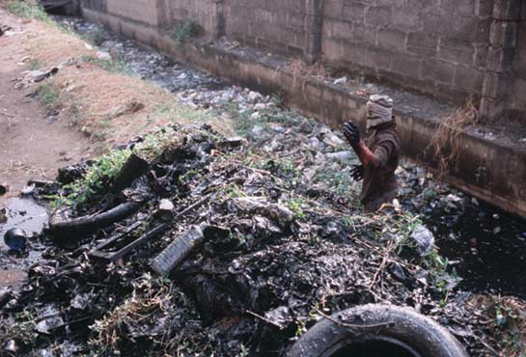
issues of urbanization include:
poverty
environmental problems
traffic congestion
lack of services such as electricity, water, sewage and garbage disposal
deteriorating infrastructure (roads and bridges, housing)
Someone Has to Do It
Photograph by Stuart Franklin
A government worker heaves more than a decade's worth of muck and debris out of a sewer in Lagos, Nigeria. Most sewers in Lagos are clogged. To help clean up the mess, the government has created a company called Drain Ducks that sends men wading into the mire.

Slide 14
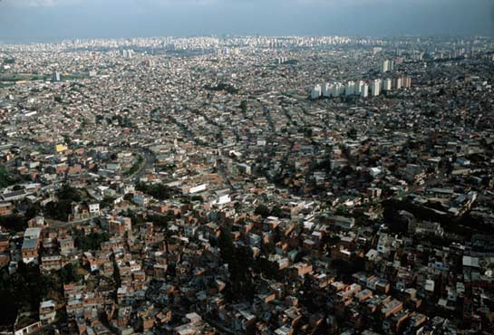
For example:
Sao Paulo- with 18 million people in the world’s largest city- sprawls from its high-rise downtown to squatter communities, or favelas, on its distant fringe. Once fashionable, the downtown core has lost many businesses and wealthy residents to newer business districts and suburbs. The favelas continually expand as waves of poor people from elsewhere in Brazil arrive to build makeshift homes on undeveloped land at city’s edge. They come to find jobs, education, and opportunity. Often what they find is unemployment, crime and despair.
Megalopolis
Photograph by Stuart Franklin
National Geographic Magazine

Slide 15
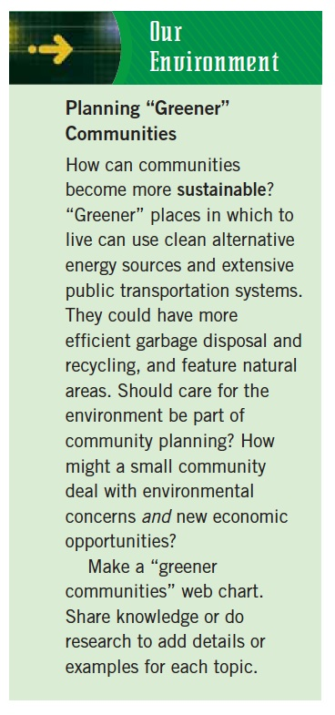
The “Greening of Cities”
Give one / Take One
List one thing that urban citizens can do to help make cities more sustainable and reduce city’s “ecological footprint”
Walk up to 3 different people and exchange your ideas
When done please return to your desk and be ready to share
Notes:
change land use planning, change transportation planning, denser residential buildings, restoring natural environments in cities, support local agriculture and community gardens, promote recycling and energy water conservation

Slide 16
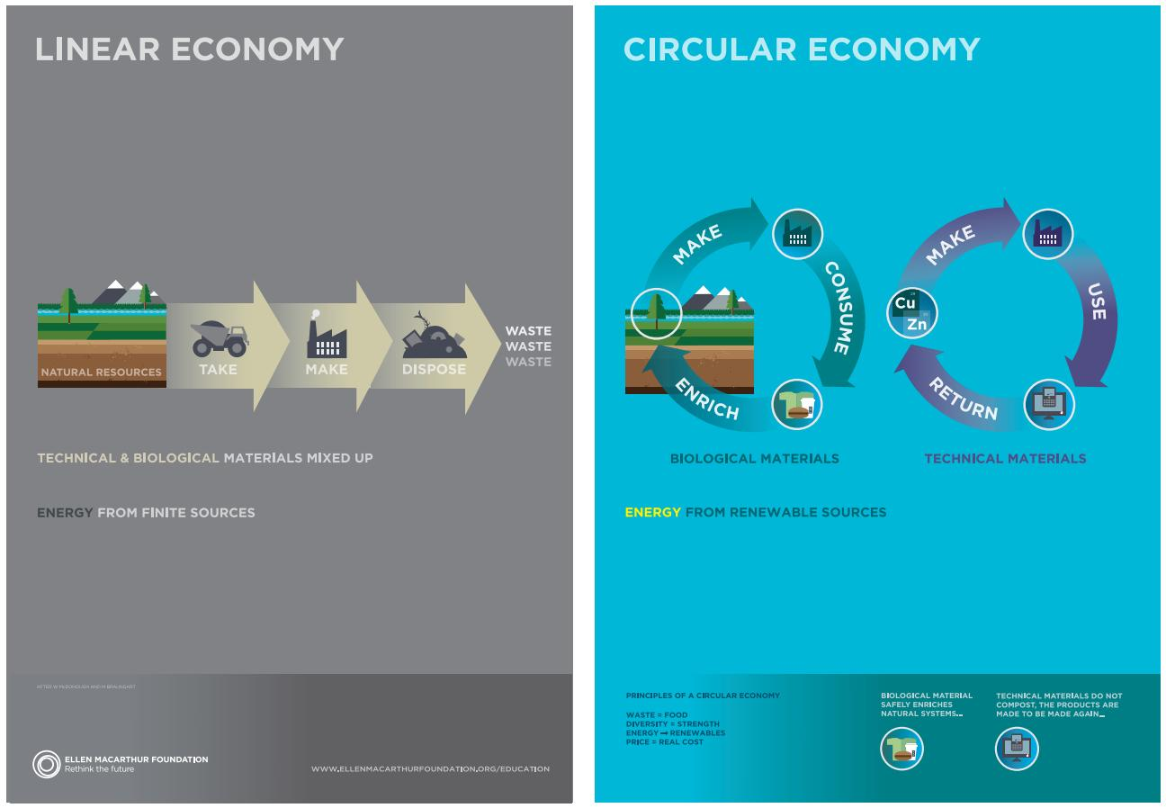
Rethinking progress:
What are the potential benefits in making the transition to a circular economy?
How could products and services be designed differently to fit this model?
Think of a product that you use on a daily basis-how might it work on a rental model, as described in the video?
“Nothing is impossible, particularly if it is inevitable” – Herman Mulder, Chairman of the Global Reporting Initiative

Slide 17
Unit review:
three patterns of settlement
site and situation
factors affecting population distribution
six factors that affect population density
population pyramids
land use
factors affecting urbanization
what are some changes in agriculture, urbanization, industrialization and transportation and how they affect the world
geography vocabulary from take home quiz

