Slide 1
A World in Motion: Movement
Grade 7 Geography
Unit: The Five Themes of Geographic Inquiry

Slide 2
Minds On:
Let’s go back to your Unit Anticipation Guide, theme # 2.
Remember, there are no right or wrong answers. By learning and gaining more information about a topic you can always change / revise / rethink your original ideas!

Slide 3
Learning Goals:
We are learning to identify the second theme in geography: movement.
Social Goal: active listening, mutual respect, participation and collaboration.

Slide 4
Action: Placemat activity
Group 1: movement of people, list the ways and reasons people move.
Group 2: movement of goods / products, list how goods/ products travel.
Group 3: movement of information, list the ways information travels.
ALL GROUPS: think of ways this affects YOU or how YOU affect the movement in the world. Also think about the positive/negative effects of movements.
Notes:
Which form of transportation do you use the most? which method is better for the people / environment? What are your favourite products? How often do you update your tech gadgets? How do they get to Richmond Hill? What resources are they made of? Which source of information do you use the most?

Slide 5
Immigration
Throughout history people have been moving around the world. It might sound easy, but some people experience difficulty migrating. There are several reasons that push people from their homelands and pull them towards somewhere new.
THINK/PAIR/SHARE: what could they be?
Notes:
You have identified many great examples of movement in the world. I would like to draw your attention to the movement of people, as Canada is the gathering place of many cultures and nations.

Slide 6
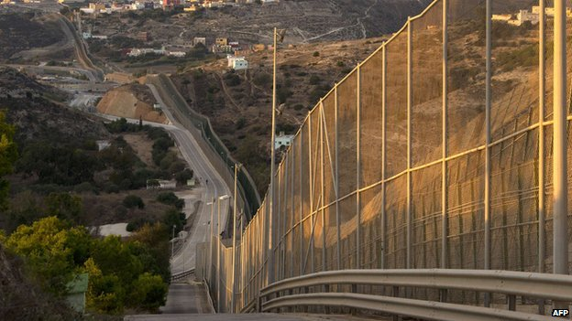
Barriers to Immigration
Physical
Financial
lack of money as barrier, visas, travel expenses…
bodies of water, deserts, human made barriers.
Melilla's (Spain) formidable border barrier tries to deter migrants desperate to get into Europe.
Retrieved March 1, 2014 from http://maytree.com/blog/2013/09/choosing-the-right-new-canadian-its-more-than-just-about-money/
Notes:
having a sponsor, having a certain amount of money in the bank account, cost of applications,

Slide 7
Barriers to Immigration
Legal
Political
criminal record, unpaid taxes, other legal issues
some countries will not allow their citizens to emigrate, while others limit the number of immigrants they accept.
Retrieved on March 1, 2014 from http://www.marketingpilgrim.com/wp-content/uploads/2011/10/shutterstock_48407311.jpg
Retrieved on March 1, 2014 from http://en.wikipedia.org/wiki/File:Flag_of_the_United_Nations.svg
Notes:
although United Nations Universal Declaration of Right states that everyone has the right to move freely, usually countries have a long process of entry or restrictions

Slide 8
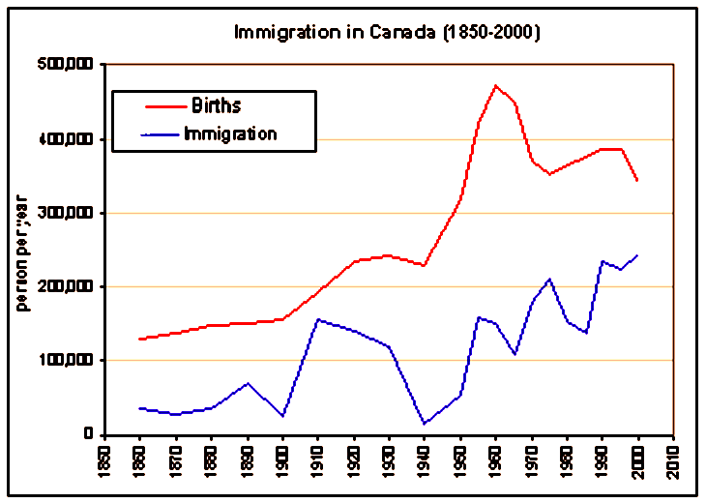
Barriers to Immigration
Emotional
Think first then share at your table group, if you or someone you know has experienced migration. What was this experience like?
people must take the risk of uprooting their families, from everything they have ever known to move to a new country
language barriers
foreign culture
some return to their homeland because of the emotional strain
Notes:
at the end of the class I would like you to choose a sticker and place yourself (your birth country) or your family’s on the world map

Slide 9
Tracking movement: positive/negative effects of GPS technology.
Retrieved March 1, 2014 from http://socialnewsdaily.com/social-media/page/29/
Let’s read the article together and discuss pros and cons of GPS technology.

Slide 10
Consolidation
ask your elbow partner what are the three things s/he learned today, be prepared to share with class

Slide 11
Homework
read and bring a current newspaper article to class on the topic of movement in geography
ask someone you know who immigrated to Canada if they experienced any barriers to immigration
complete “Movement” article and find main ideas for each paragraph
First assignment (Place/ Location/ Movement) is due after March break ☺

