Slide 1
Geography
Place

Slide 2
Minds On
What kind of first-hand experiences have you had with geography? (family trips, reading maps, using GPS, Google Earth, asking for directions, moving to a new city or country) THINK PAIR SHARE

Slide 3
LEARNING GOALS FOR TODAY
We are learning to explain the geographic concept of location / place.
We are learning to use maps to locate places.
Social goal: active listening, mutual respect, participation.

Slide 4
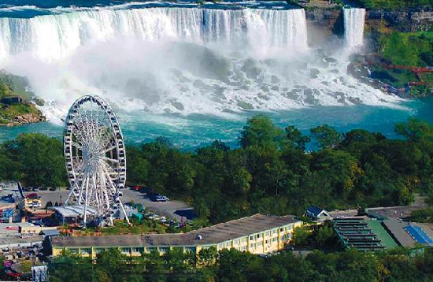

Slide 6
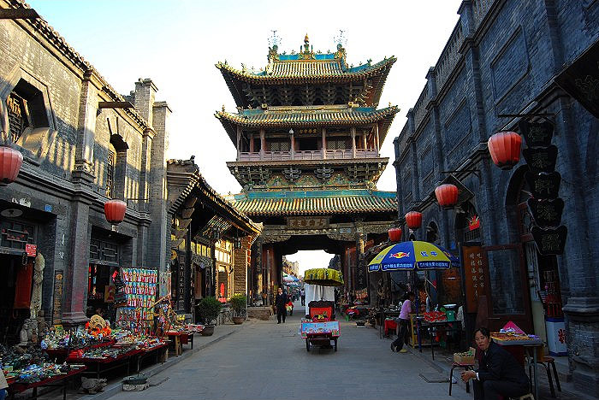
Where is this place? How do you know?

Slide 9
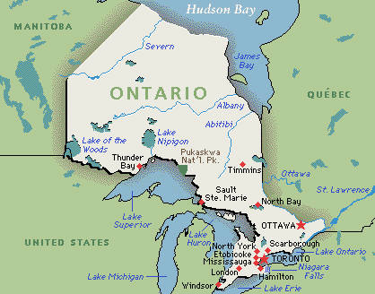

Slide 10
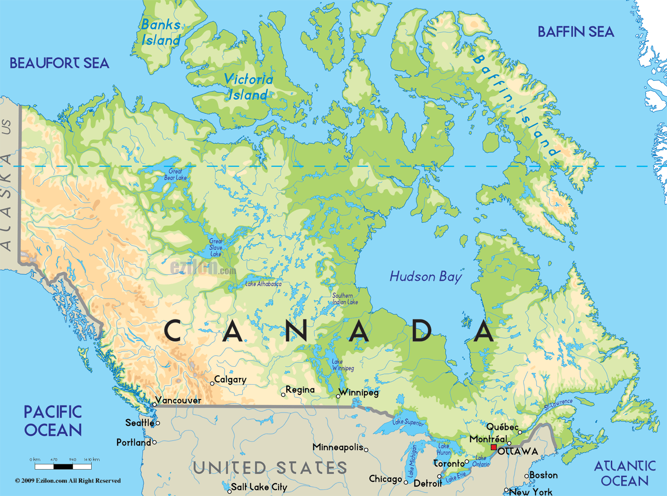

Slide 11
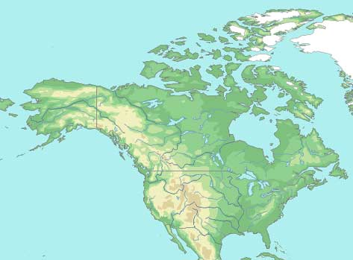

Slide 12
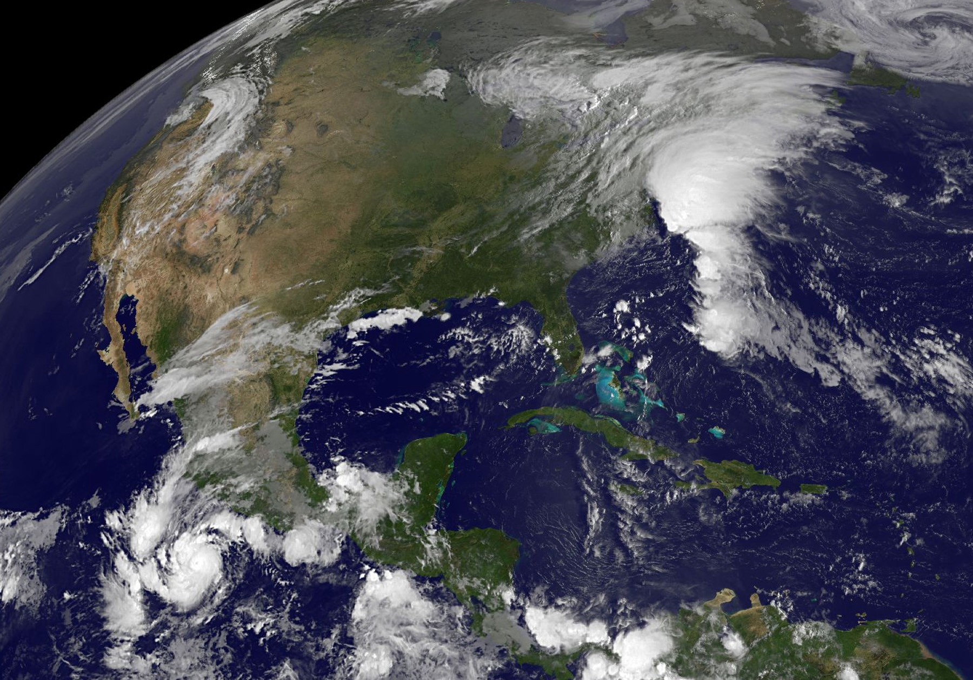

Slide 14
A place is a general term.
It can vary in size from a single room to the Sahara desert. The planet Earth is a place and so is the neighbourhood you live in.

Slide 15
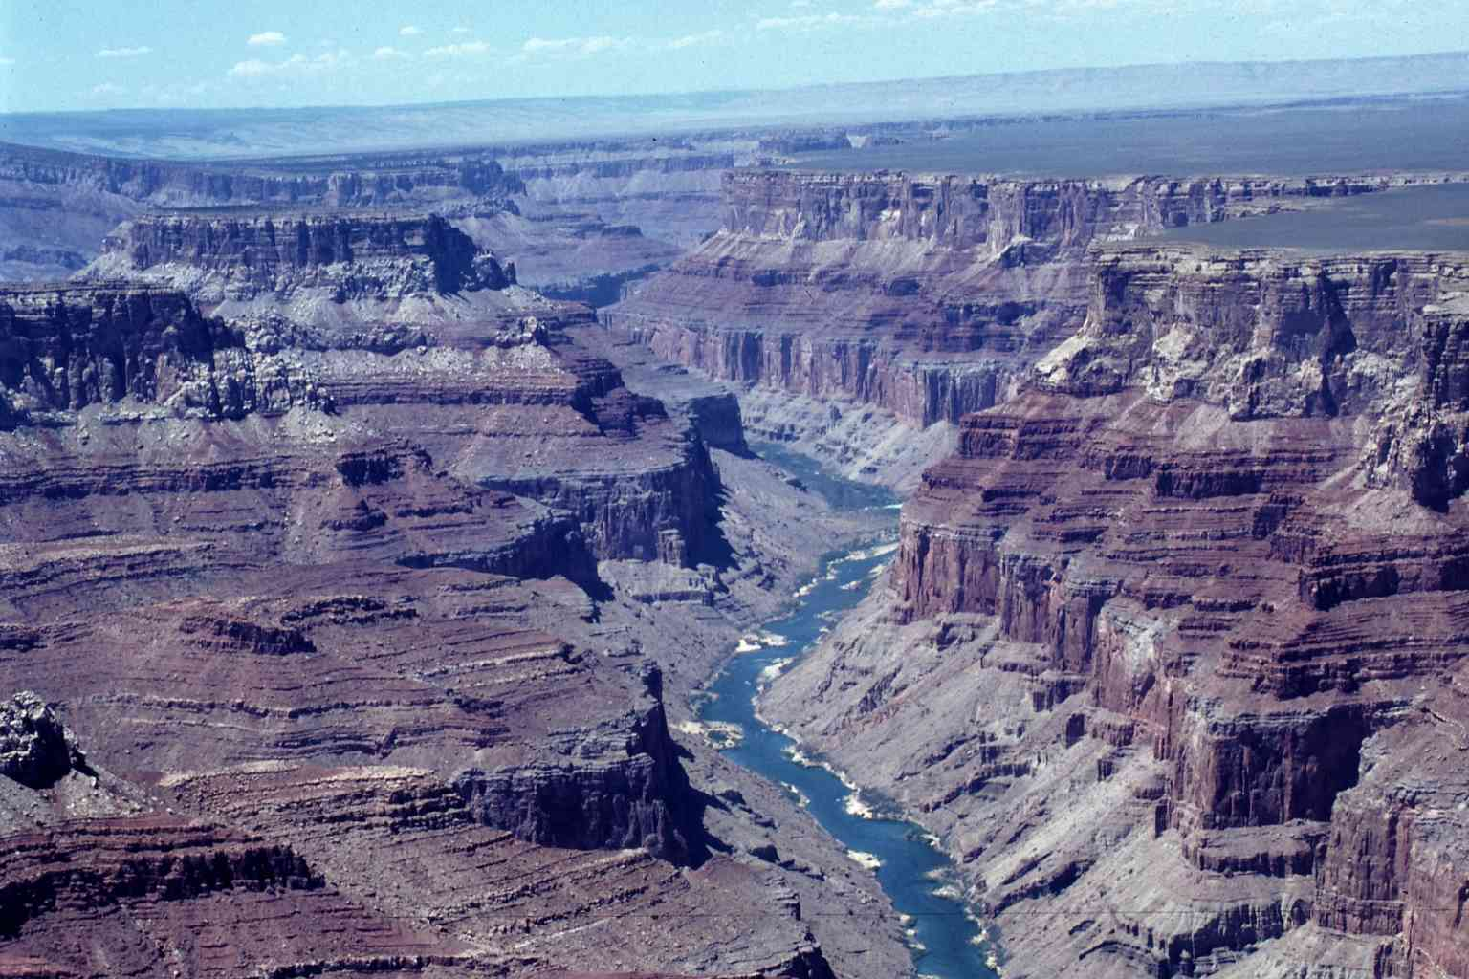
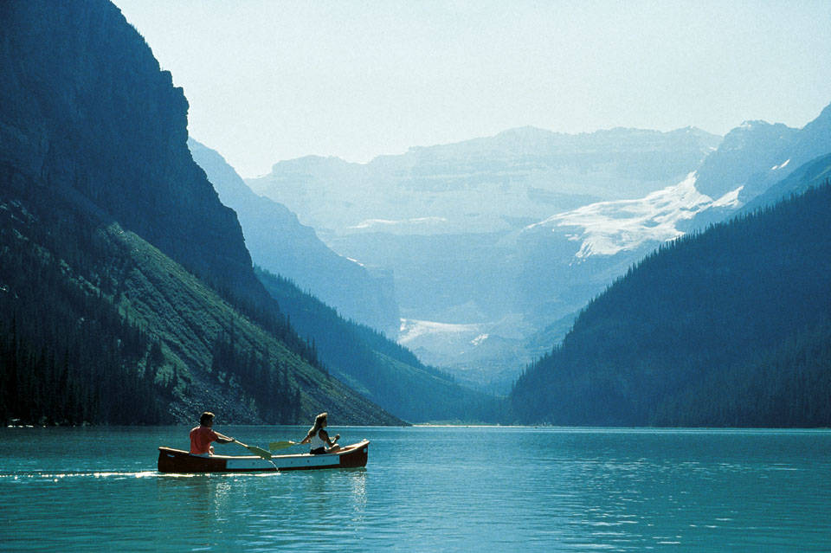
A place has natural physical properties that are unique to it such as landforms and bodies of water.

Slide 16
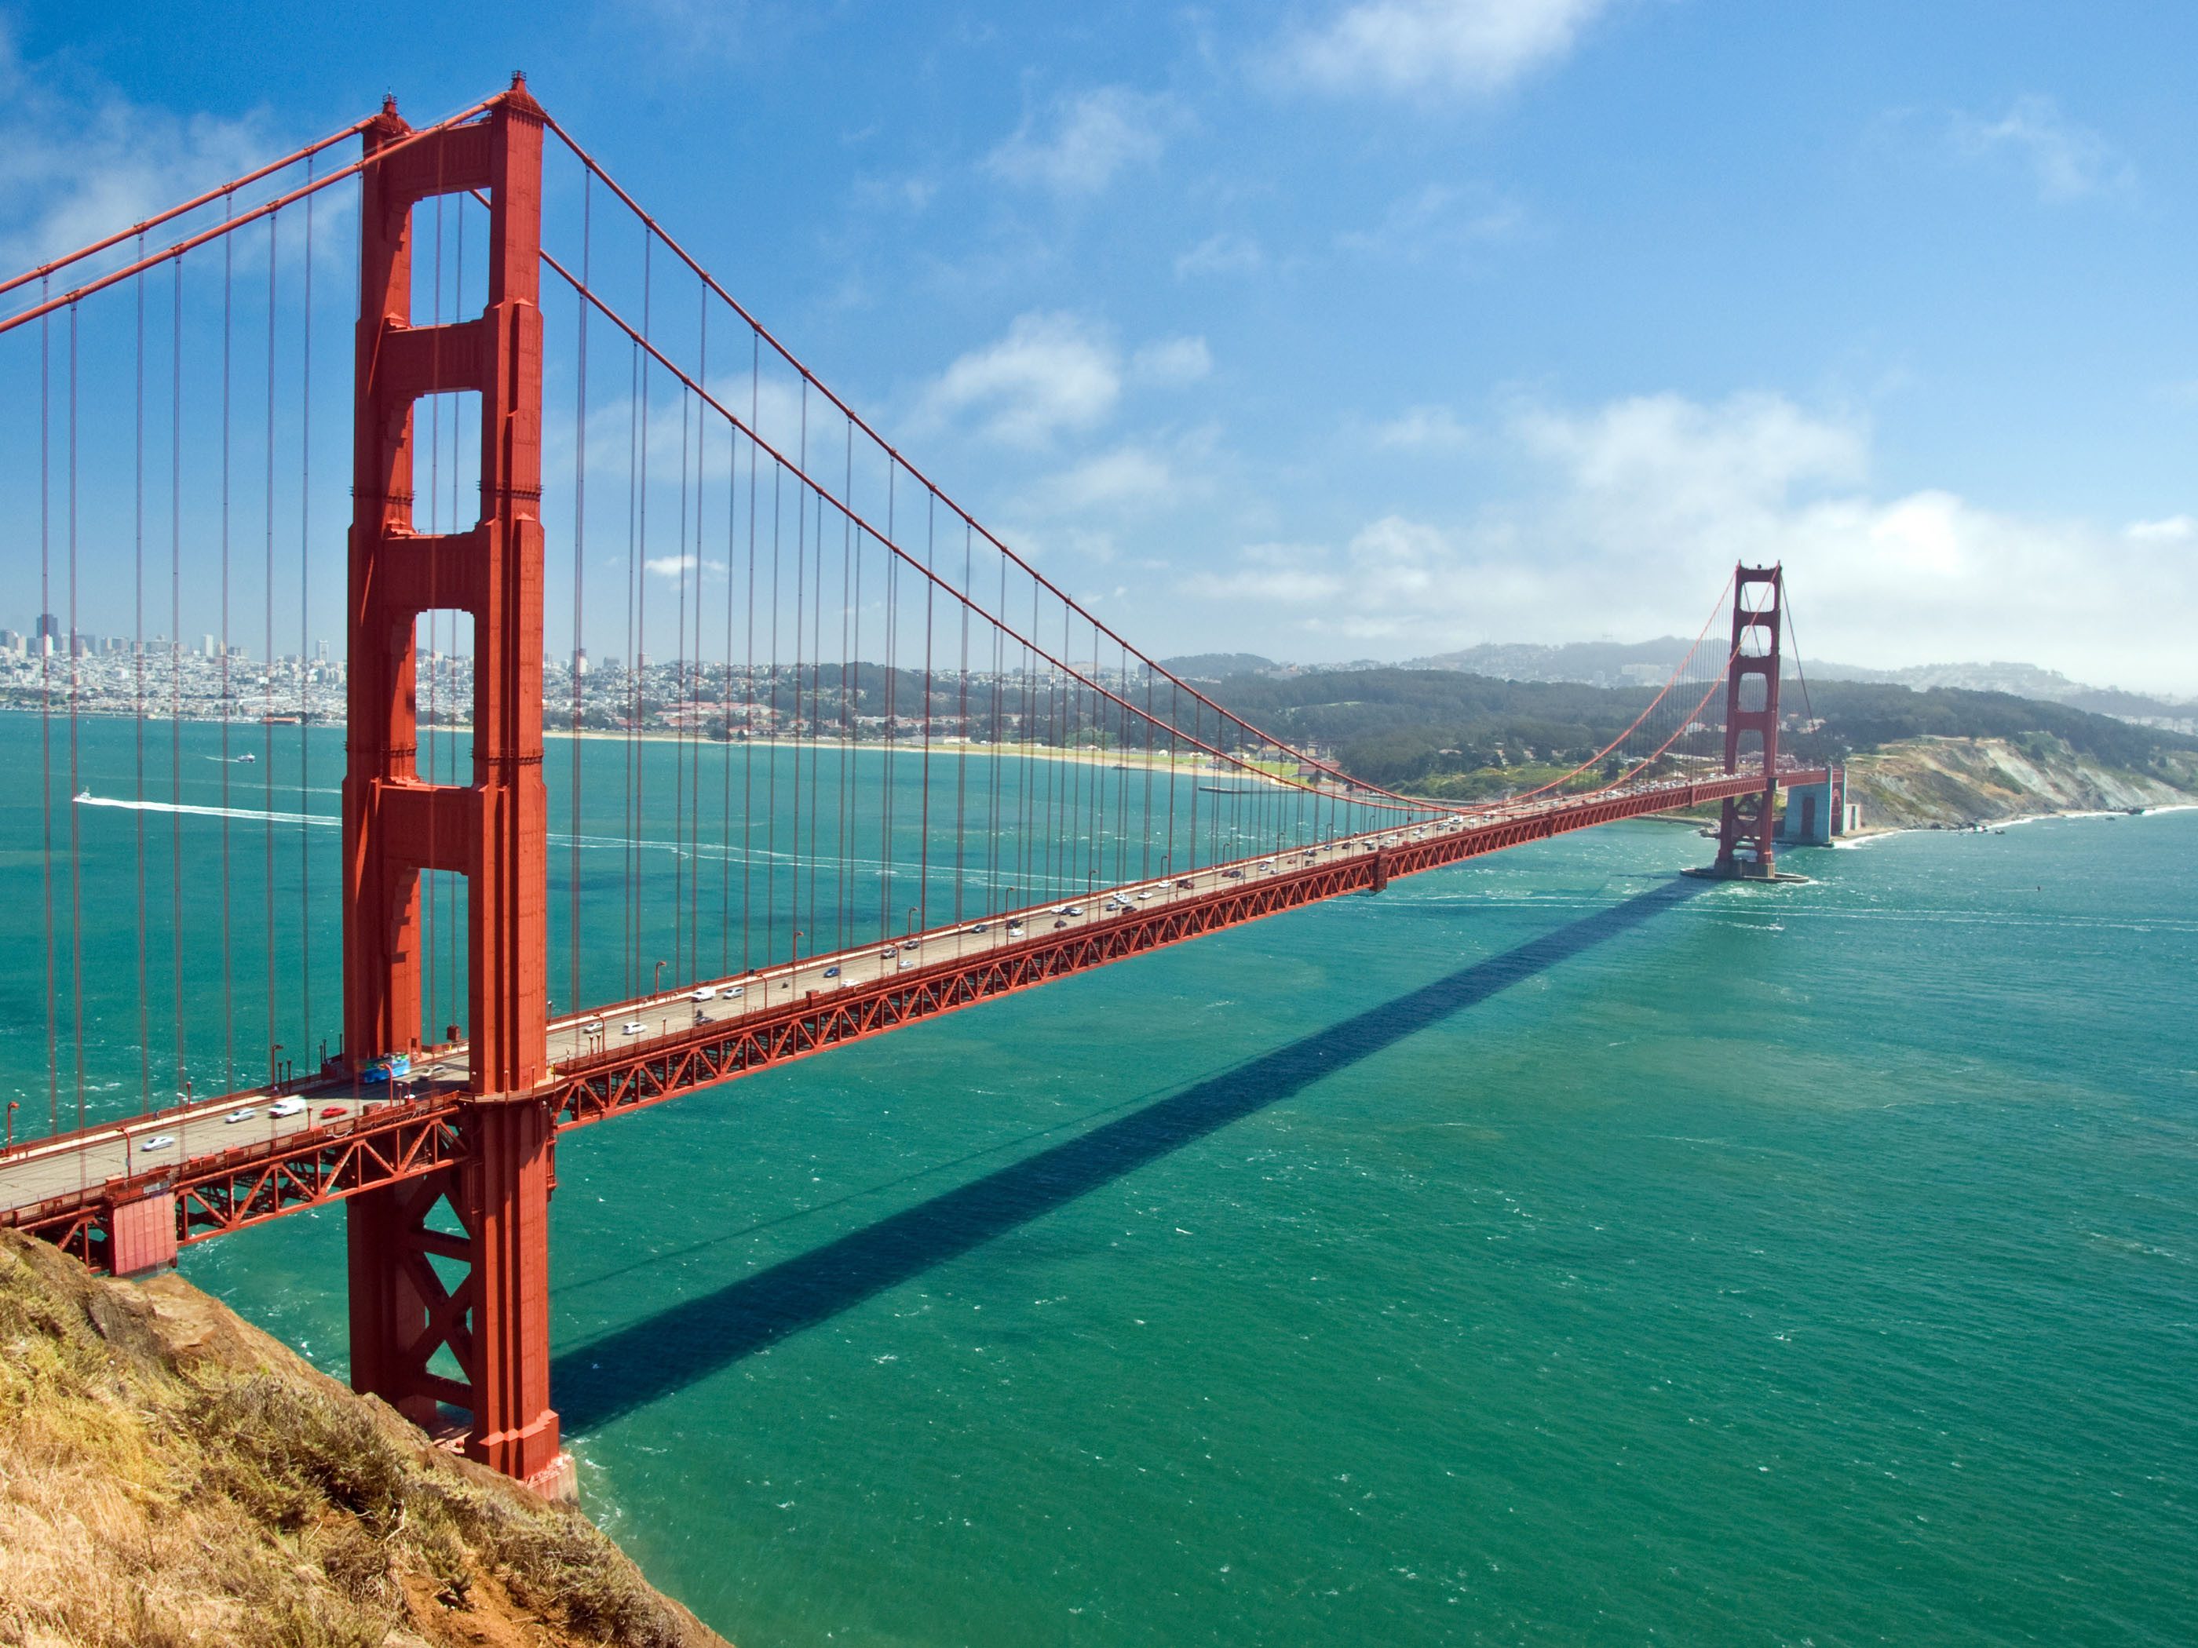
A place has human made characteristics such as buildings, roads, signs, and clothing.

Slide 17
A Place is a combination of natural physical features and human made characteristics.
Where is the single most important question in geography. You can answer this question using two methods: using relative location or absolute location.
Relative location describes one place in relation to another. Some people give relative location by using familiar landmarks and giving directions or using a compass directions and distance.
Absolute location is the exact location of a place, independent of any other place. The system of longitude and latitude is an example of absolute location.

Slide 18
I need one volunteer to demonstrate giving relative location using landmarks and giving direction.
I need a second volunteer to demonstrate giving relative location using a compass rose and distance.

