Slide 1
Population Characteristics: How People Live
Grade 8 Geography Unit: Human Patterns

Slide 2
What is demography?
It is the study of human population: statistics of the area’s population relating to such aspects as age, sex, income and education.
Demographers are scientists who study data on population and issues related to where and how people live.
They are trying to understand why people live where they do and why some countries have population problems.

Slide 3
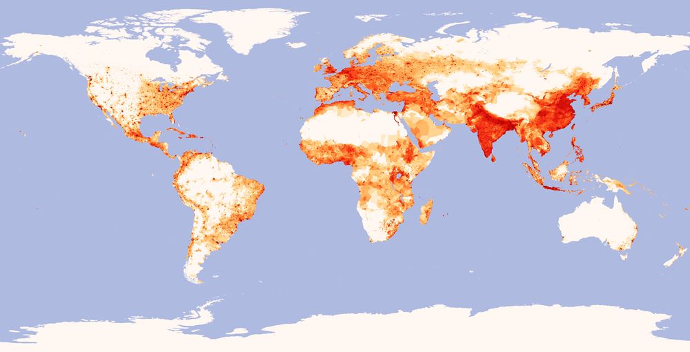
Minds On:
Look at the map of world population density on page 290. What patterns do you notice? Which parts of the world are uninhibited?
Think / Pair /Share
Quick review from our last class:
What are the 4 factors that affect
where people live?
Now look at Figure 1.23 at page 20. What correlations can you see between water supply and population distribution?

Slide 4
Learning Goals:
We are learning to identify terms describing population characteristics such as birth rate, death rate, literacy rate and life expectancy.
We are learning to understand how to determine quality of life using population characteristics.
Social Goal: active listening, mutual respect and participation.

Slide 5
Minds On activity
Choose and write down 5 quality of life factors that YOU feel are important.
Let’s popcorn your ideas and thinking!
Let’s also review the definitions of developed and developing countries.

Slide 6
Quality of Life definition
Quality of life is the amount of satisfaction we have with our lives, taking into account both material (e.g. money) and non-material wealth (e.g. education).

Slide 7
Action:
Population characteristics are factors that tell us how a population is changing or how well people live in a country.
Anyone who plans for the future: governments, corporations, school systems, hospitals needs information about population characteristics.
What are Population Characteristics?

Slide 8
There are many different population characteristics such as birth rates, death rates, literacy rates and life expectancy that determine quality of life.
Birth rate tells us the number of babies who are born each year for every 1000 people in a country.
The birth rate in Canada is 10 births per 1000 people in one year.
The birth rate in Uganda is 47 births per 1000 people in one year.

Slide 9
What is Fertility Rate?
The average number of babies born in a woman’s lifetime in the country.
In Canada, the fertility rate is 1.58 children born per woman
In Uganda, the fertility rate is 6.3 children born per woman
Why are there higher fertility and birth rates in developing countries?

Slide 10
Fertility rates are higher in developing countries because:
Many parents will have a lot of children in the expectation that some will die because of the high infant mortality rate.
Large families can help in looking after the farm.
The children will be able to look after their parents if they become old or sick; there may not be a old age pension plan.
There may be a shortage of family planning facilities and advice.
Why are there lower birth rates in developed countries?
What do you think is the best family size?
Think/ Pair/ Share

Slide 11
Fertility rates are lower in developed countries because:
It is expensive to look after large families.
More women prefer to concentrate on their careers.
Increasing sexual equality has meant women have more control over their own fertility.
There is a ready availability of contraception and family planning advice.

Slide 12
Population characteristic: death rate.
Death rate tells us the number of people who die each year for every 1000 people in a country.
The death rate in Canada is 7.8 per 1000 people in one year.
The death rate in Uganda is 11.9 per 1000 people in one year.

Slide 13
Let’s compare:
Why are death rates higher in developing countries?
Why do developed countries have lower death rates?
Dirty, unreliable water supplies
Poor housing conditions
Poor access to medical services
Diets that are short in calories and/or protein
Good housing conditions
Safe water supplies
More than enough food to eat
Advanced medical services which are easy to access

Slide 14
Going up or going down?
One reason country’s population changes is that people are born and die each year.
If the number of births is higher than the number of deaths, the population will go up.
When the population goes up because the birth rate is higher than the death rate it is called a natural increase.
When birth rates are lower than the death rate, country’s population will go down. Italy, Germany and Japan all have decreasing populations.

Slide 15
Population characteristic: literacy rate.
A measure of the population over 15 years of age who can read and write.
Literacy rates are usually measured in percentages. It tells us how much of a population can read and write.

Slide 16
Literacy rate
Why is it important?
Per capita income
Literacy rates are important because they can indicate the education level the population is at.
High literacy levels predict better careers or potentially higher paying careers.
Average amount of money earned by each person in a country for one year.
It is usually measured in American dollars.
Higher literacy rates in a country mean higher per capita income.

Slide 17
Let’s look at the earning power of education in Canada.
What can you infer from the graphs?

Slide 18
Gross Domestic Product
GDP is another statistic often used to measure quality of life.
GDP per capita is calculated by dividing the country’s total GDP by the number of people living in the country.
Can be misleading, especially if there is a large income gap within the population.
GDP per capita can be used to indicate the difference between developing and developed countries.
It is a total value of all goods and services produced in a year in a given country.
Canada’s GDP: 1.34 Trillion Dollars
India’s GDP: 9 Billion Dollars
Notes:
If you are interested in learning how this can be misleading I have a great article by David Suzuki which I can photocopy for you

Slide 19
Population characteristic: life expectancy.
Life expectancy is the number of years that a baby born in a particular year can be expected to live under current conditions.
A long life expectancy tells us that the population is living in conditions that support health.
Health care, food abundance, clean water – all contribute to a longer life expectancy.

Slide 20
Doubling Time
What is it?
The average doubling time for industrialized, more developed countries is 500 years.
The average doubling time for less developing countries is 37 years.
It is important to know how fast population is growing so that government can plan for the future food, housing, health care, education, etc.
The time it takes for a country’s population to double in number.
The faster the population is growing, the shorter the amount of time it will take for the population to double. What could be some of the problems faced by the people and government?

Slide 21
What do you think is the best country to live in the world? Let’s make a list of top 10.
Notes:
Who do you think decides which country is the best country to live in the world?

Slide 22
How is this decided?

Slide 27
Homework:
Textbook: read pg. 22-29
+
Take home quiz: due first class after March Break ☺

